Slide 1
Operations, Troubleshooting and Visibility
ACE Solutions Architecture Team

Slide 2

Operational Challenges in Public Cloud
1
2
3
4
5
6
7
Evidential Data
A Flat World in Public Cloud
When working with Cloud Providers, often customer is challenged to prove providers fault/issues
There is a lack of hierarchy in the cloud which means its hard to insert security, control and visibility
Unfamiliar Toolset
Native cloud lacks familiar tools like ping, packet capture, traceroute
Tier-3 becomes Tier-1
Frontline support teams don’t have the skill and tools in public cloud requiring senior network engineers to assist with most support issues
Blackbox – No visibility
Native cloud constructs want you to trust all is well always. No visibility into logs, current state, routing tables, etc.
Scaling Out
Infrastructure as Code
Real problems are experienced when architecture scales out as it very quickly grows to be complex and very hard to troubleshoot
Solves agility problem, creates support issues as tier-1 is not able to troubleshoot code problems

Slide 3
Infrastructure as Code

Slide 4
What it is
Use Infrastructure as Code to provision and manage any cloud, infrastructure, or service
Write declarative configuration files – define desired state
Plan and predict changes
Create reproducible infrastructure – if resource already exists, it won’t recreate it
Maintains knowledge of resources in a database called State
State maps config to real world

Slide 5
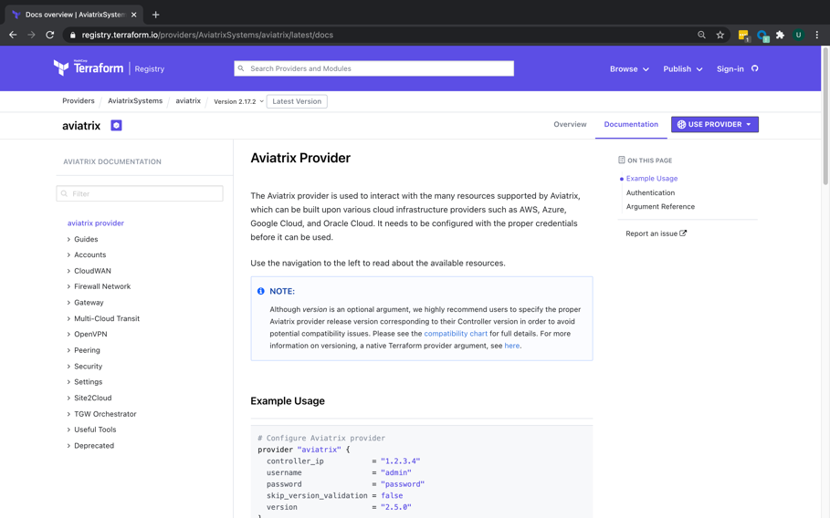
Aviatrix Terraform Provider
Multi-lingual entity responsible for API interactions with CSPs
Exposes resources in those CSPs for any account/subscription that has been onboarded
Feature parity with Controller code

Slide 6
Aviatrix Terraform Resources – Examples
# Create an Aviatrix AWS Gateway
resource "aviatrix_gateway" "test_gateway_aws" {
cloud_type = 1
account_name = "devops-aws"
gw_name = "avtx-gw-1"
vpc_id = "vpc-abcdef"
vpc_reg = "us-west-1"
gw_size = "t2.micro"
subnet = "10.0.0.0/24"
}
# Create an Aviatrix Azure Gateway
resource "aviatrix_gateway" "test_gateway_azure" {
cloud_type = 8
account_name = "devops-azure"
gw_name = "avtx-gw-azure"
vpc_id = "gateway:test-gw-123"
vpc_reg = "West US"
gw_size = "Standard_D2"
subnet = "10.13.0.0/24"
}

Slide 7
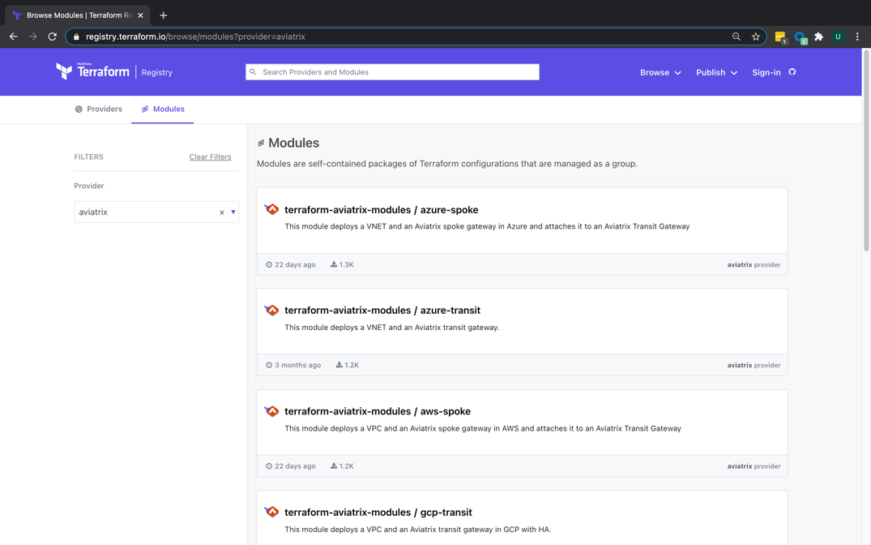
Aviatrix Terraform Modules
“Repeatable++”
Similar to the concepts of libraries, packages, or modules found in most programming languages
Provide many of the same benefits
~10X reduction in lines of code
Can be found on Terraform Registry

Slide 8
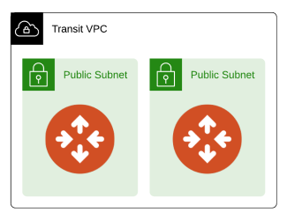
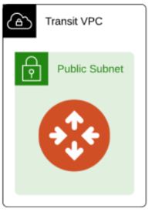
Aviatrix Terraform Module – Example
# Create a VPC and a set of Aviatrix transit gateways.
module "transit_aws_1" {
source = "terraform-aviatrix-modules/mc-transit/aviatrix"
version = ”1.1.2”
cloud = “aws”
cidr = "10.1.0.0/20"
region = "eu-west-1"
account = "AWS-account"
}
ha_gw set to true by default

Slide 9
Upgrade Process

Slide 10
Important Points to Remember for Upgrade
The controller is the control plane
CoPilot is the management plane
Upgrade process is designed in a modern / cloud-native / born-in-the-cloud way that is hitless and much faster than on-prem upgrades.
Upgrade time depends on many factors.
Customer Data Point: 500 GWs environment → ~22 min to upgrade
You can perform the following operations on selected gateways:
Perform a Platform Software Upgrade Dry Run
Perform a Gateway Software Upgrade Dry Run
Upgrade the Platform Software
Upgrade the Gateway Software
Roll Back the Gateway Software
Upgrade the Gateway Image
All details at https://docs.aviatrix.com/HowTos/selective_upgrade.html

Slide 11
Best Practices for Upgrade
Use Staging environment to test new features out
Perform upgrades in a maintenance window
Read the documentation before planning your upgrades
https://docs.aviatrix.com/HowTos/UCC_Release_Notes.html
https://docs.aviatrix.com/Support/support_center_operations.html#pre-op-procedures
https://docs.aviatrix.com/HowTos/inline_upgrade.html
https://docs.aviatrix.com/HowTos/field_notices.html
Stage the upgrade with a Dry Run to assess the following:
Reachability between the controller and the release server
Reachability between the controller and gateways
Free memory on controller and gateways
Disk space on controller and gateways
CPU low enough on controller and gateways
Only if all green, should you proceed with upgrade

Slide 12
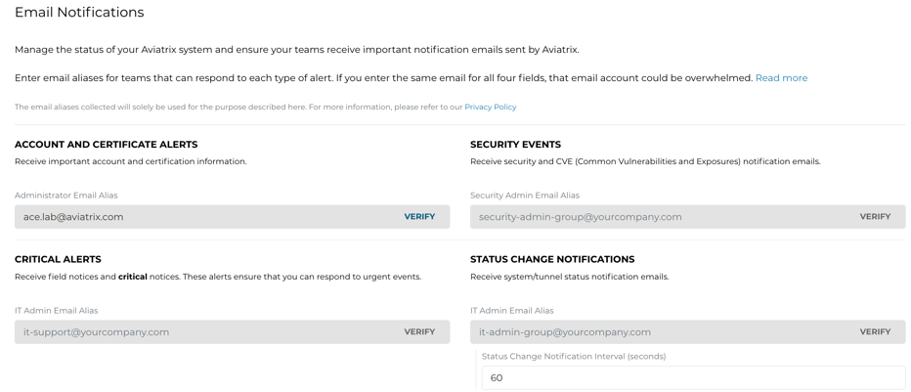
Support Portal
Aviatrix customers may visit Support portal – https://support.aviatrix.com to access:
Knowledge Base with videos
Documentation
Community
History of tickets
CSP outage tracker
Sign up for Email Notifications

Slide 13
Aviatrix Learning and Testing Tools
For Pre-upgrade /SRE/Learning/Study/etc.

Slide 14
What Sandbox Starter Tool Builds
Controller launch (Metered or BYOL)
VPC and all networking
Security Groups
Key pairs
IAM roles and policies (only if they don’t already exist)
EC2 instance
Username and password
Software upgrade
AWS account onboarding
Configuring License (BYOL)
MCNA launch
Azure account onboarding
AWS VPCs and Azure VNets
Spoke and Transit
ActiveMesh Transit in AWS
Spoke gateways
Transit gateways
Spoke attachment to Transit
Same ActiveMesh Transit in Azure
Transit peering between AWS and Azure
https://youtu.be/nKhJ2wv2OZE

Slide 15
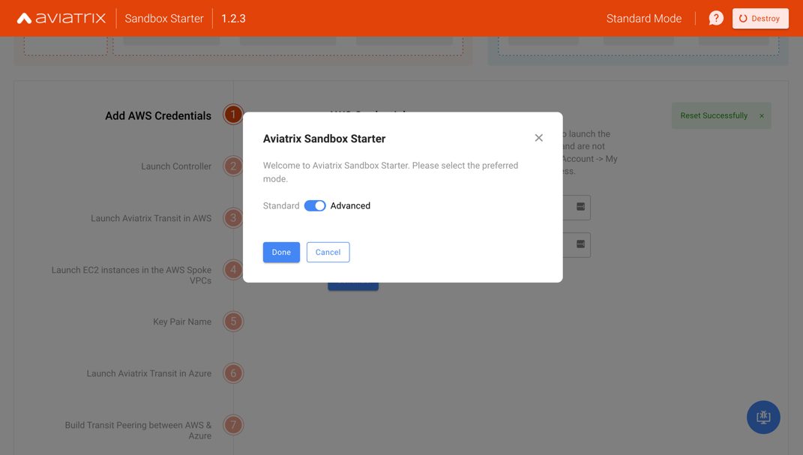
Sandbox Starter Tool Modes
Standard Mode
Fixed regions, resource names, and CIDR blocks
Advanced Mode
Customizable regions, resource names, and CIDR blocks
https://youtu.be/nKhJ2wv2OZE
14

Slide 16
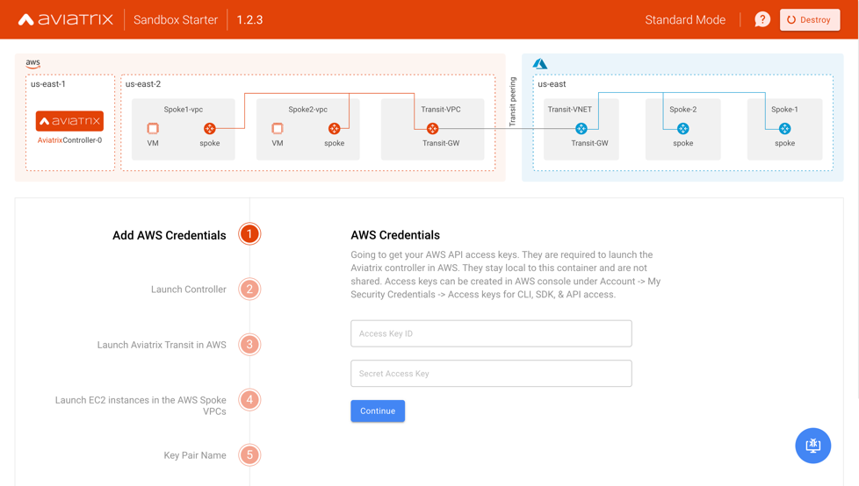
Sandbox Starter Tool Workflow Start
15

Slide 17
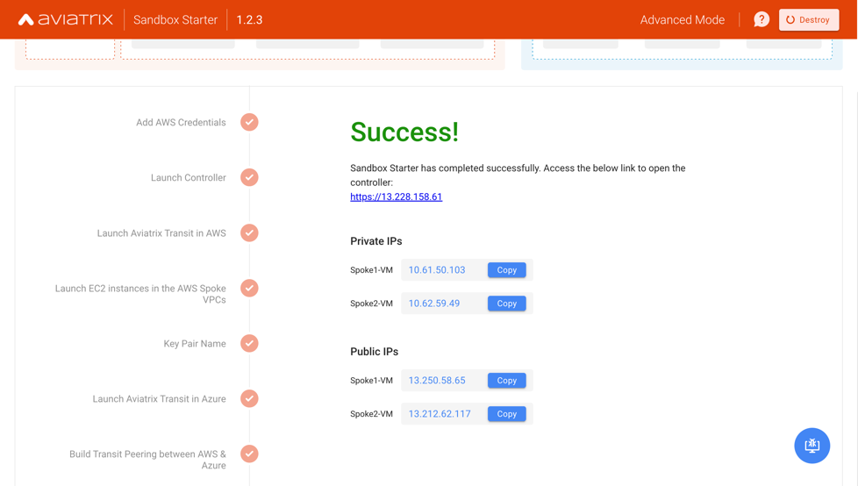
Sandbox Starter Tool Workflow Completion
16

Slide 18
Next: Let’s Design Together

Slide 19

Build your own MCNA Transit at ~$1/hr
Goal: Fast path for Customers and Partners to deploy Aviatrix multi-cloud transit foundation with minimal cost
Turn-key solution to deploy Aviatrix Controller + MCNA in AWS and Azure + test instances with extreme simplicity and flexibility
Can be deployed in 3 different ways:
Local (BYO Docker)
AMI
AMI with Terraform module
Description | Unit Cost | Quantity | Hourly Cost | Cost for 8 hours | Cost for 24 hours
Aviatrix Controller in AWS (t3.large) | $0.09 | 1 | $0.09
Aviatrix Gateway in AWS (t2.micro) | $0.01 | 3 | $0.03
Test instances in AWS (t2.micro) | $0.01 | 2 | $0.02
Aviatrix Encrypted Peering (AWS) | $0.23 | 2 | $0.46
Total Cost for AWS-only Transit + 2 Spokes |  |  | $0.60 | $4.80 | $14.40
Extending into Azure
Description | Unit Cost | Quantity | Hourly Cost | Cost for 8 hours | Cost for 24 hours
Aviatrix Gateway in Azure (B1s) | $0.01 | 3 | $0.03
Aviatrix Encrypted Peering (Azure) | $0.23 | 2 | $0.46
Aviatrix Transit Peering (between AWS and Azure) | $0.70 | 1 | $0.70
Total Cost for MCNA (including minimal network egress charges) |  |  | $1.19 | $9.52 | $28.56
User guide: https://community.aviatrix.com/t/g9hx9jh

Slide 20
Aviatrix Controller High Availability (HA)

Slide 21

Aviatrix Controller High Availability (HA)
Very important: The Controller is not in the data path
If the Controller is down → , the Data Plane still functions
Your cloud network is still up and running
Do not compare on-prem to cloud
Hardware devices cannot be replaced / software is more flexible
Cloud operating models are different
Cloud processes are different
We need a fresh and different look to solve

Slide 22

Aviatrix Controller HA Process
Takes minutes to switch over to new controller
Depends on factors such as AWS latency, instance type, size of the DB, etc.
Previous controller is terminated
All existing configuration is restored
New Private IP is assigned (new AZ)
New controller stays at the same version as previous
Switchover
Old
New
https://docs.aviatrix.com/HowTos/controller_ha.html
https://github.com/AviatrixSystems/Controller-HA-for-AWS/

Slide 23

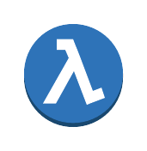

Aviatrix Controller HA Process
Aviatrix Controller HA operates by relying on an AWS Auto Scaling Group.
The Auto Scaling Group has a desired capacity of 1
If the Controller EC2 instance is stopped or terminated, it will be automatically re-deployed by the Auto Scaling Group
An AWS Lambda script is notified via SNS when the Auto Scaling Group launches new instances
This script handles configuration restoration using the most recent Controller backup file, stored in S3
S3
Backup
=1
NW
SNS

Slide 24
Two tools to deploy a cookie cutter topology
Aviatrix Self-Service Launch Tool (SSLT)
https://selfservice.aviatrix.com
SaaS style implementation
Today, support only AWS MCNA topology
Two use cases: NAT-Gateway Cost Saving and Controller/CoPilot solo deployment
You can extend to any use-case you want
Aviatrix Sandbox Stater Tool (SST)
Sandbox EC2 on AWS community AMI with built-in server and UI
Open Source
Support AWS and Azure MCNA topology
Hub and Spoke with test instance
Extend to any use-case you want

